Slide 1
ARM Cortex-M & STM32 Foundations
Lecture 1
From CPU philosophy to MCU reality

Slide 2
Why CPU Architecture Matters
Software runs on architectural guarantees
Architecture defines timing, power, and behavior
Bad assumptions lead to bugs and latency issues
Importability of software becomes a big issue, leading to the classic developer excuse – “Well, it worked on my machine!”
There was and still is an innate need for standard architecture, and thus, 2 philosophies emerges.

Slide 3
RISC vs CISC – Big Picture
CISC: complex, multi-operation instructions
Let the number of instructions be small, but let each instruction be bloated and bulky.
Let the code be small in size, but execute slower due to heavier instructions.
RISC: simple, predictable instructions
Let the number of instructions be large, but let each instruction be minimal and light.
Let the code be large(er) in size but execute faster, due to lighter instruction weight.

Slide 4
ARM = RISC at Scale
ARM (Acorn RISC Machines / Advanced RICS Machines) is an extension of the RISC philosophy.
They don’t make anything. Instead, they design CPU architectures and sell the license to use them for literally any purpose imaginable.
Used from microcontrollers to servers

Slide 5
Why One CPU Can’t Do Everything
Different systems need different guarantees.
You cannot control a RC car and a Formula One car with the same CPU, can you?
Some demand more Virtual memory, some need more real-time capability, some demand ultra-low power operation.
One architecture cannot optimize for all! (Not everyone is Jacques Kallis)

Slide 6
ARM Cortex Families
Cortex-A → Applications & Operating Systems
The Tank - the heavy hitter, built for brute-force compute and full OS stacks.
Cortex-R → Real-time & Safety
The Head-Master - strict, disciplined, enforces timing and correctness.
Cortex-M → Microcontrollers
The Swiss-Army Knife - versatile, efficient, and designed to quietly do everything the system needs.

Slide 7
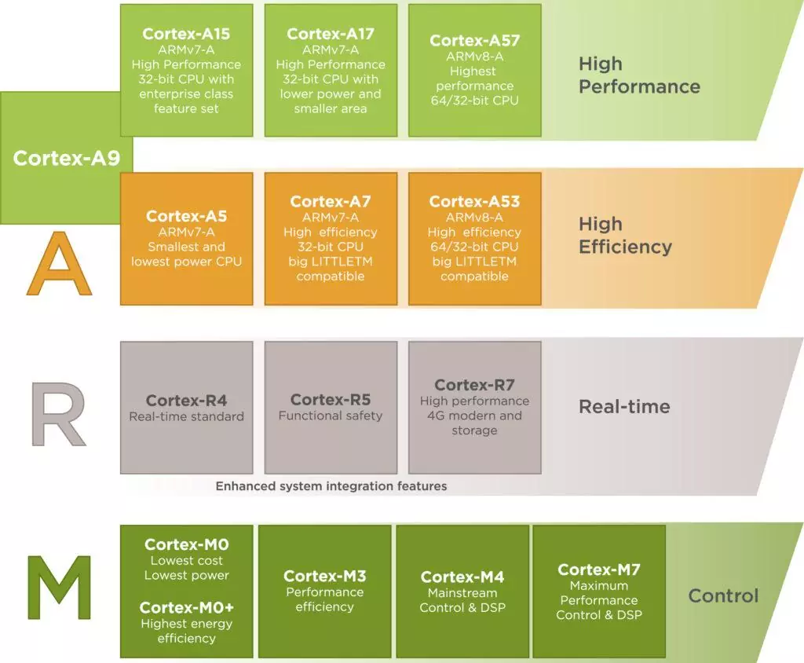

Slide 8
Cortex-A (High Level)
MMU with virtual memory and user/kernel separation
High throughput via caches, OoO execution, SIMD
Designed to run Linux / Android.
Used in phones, SBCs, networking gear, servers.

Slide 9
Cortex-R (High Level)
Deterministic execution with bounded latencyHard real-time guarantees
Hard real-time guarantees and fast interrupt response.
Safety features: ECC, lock-step, fault detection.
Used in automotive, storage, and industrial control.

Slide 10
Cortex-M (High Level)
Simple, power-efficient, and deterministic designBare-metal or RTOS.
Bare-metal or RTOS-based execution.
Very low interrupt latency with integrated NVIC.
Used in sensors, motor control, wearables, embedded systems.

Slide 11
Why Cortex-M Dominates MCUs
It’s Cheap, it’s powerful, and it gets the job done WHILE consuming the least milliwatts of electricity.

Slide 12
Cortex-M4 in One Slide
32-bit RISC core
DSP instructions
Optional Floating-Point Unit
Real-time friendly design
Area and Power efficiency
Sleep and Deep-Sleep states
SIMD instructions
MAC Operation
And the list goes on and on

Slide 13
Pipeline Concept
3-stage pipeline
Fetch → The processor reads the next instruction from program memory (Flash) using the Program Counter (PC) and places it into the instruction pipeline. At the same time, the PC is updated to point to the following instruction, allowing continuous instruction flow.
Decode → The fetched instruction is decoded to determine the operation to be performed, which registers are involved, and whether any operands need to be read. During this stage, the processor prepares the control signals and reads required register values
Execute → The instruction is carried out: the ALU performs arithmetic or logical operations, memory is accessed for load/store instructions, branches are resolved, and results are written back to registers. For Cortex-M, this stage is also where load/store and interrupt entry can occur.

Slide 14
Interrupt Philosophy
Interrupts are first-class citizens – these signals enjoy priority over other signals on the MCU.
NVIC tightly integrated into the core, letting the interrupts have direct access to the CPU.
Hardware context save and restore – the current context of the hardware is put on hold, till the Interrupt is serviced. Then, it gets resumed!

Slide 15
MCU ≠ CPU
CPU is just the core. Like the lava in a choco-lava cake – the central piece, for sure but not the complete package.
Remember, MCU = core + memory + peripherals.

Slide 16
Programmer’s Model
This, is what the CPU wants the Programmer to look at itself as.
Basically, it’s the answer to the question- What does the CPU look like from the point of view of software?

Slide 17
Operational Modes
There are two, thread and handler.
Thread –
This is the normal execution mode where application code runs (e.g. main(), background tasks, RTOS threads).
Code executes sequentially and can be pre-empted by interrupts or exceptions.
Thread mode can run as privileged or unprivileged, depending on system configuration.
It can use either the MSP or the PSP as its stack pointer.
Handler –
Entered automatically when an exception or interrupt occurs.
All ISRs and fault handlers execute in Handler mode.
Always runs in privileged state and always uses the MSP.
Entry and exit are fully hardware-managed (context save/restore).

Slide 18
Registers
There are 16 architectural registers: R0 – R15
R0 – R12: general-purpose registers
Hold data, variables, intermediate results
Primarily used by the compiler
R13 – R15: special registers controlling execution flow.
R13 – Stack Pointer (SP) Points to the current top of the stack.
R14 – Link Register (LR) Stores return address during function calls.
R15 – Program Counter (PC) Holds address of the next instruction to execute
Finally, the special Registers, namely the PSR, PRIMASK, FAULTMASK, BASEPRI and CONTROL register

Slide 19
Stack and Stack Pointers
The Processor runs a FULL-DESCENDING STACK. When the processor pushes a new item onto the stack, it decrements the stack pointer and then writes the item to the new memory location.
There are 2 stack pointers, MSP and PSP.
The MSP is typically used for exception and interrupt handling.
The PSP is intended for application code, especially in RTOS-based systems.
For the software, there exists only one stack pointer, but the processor switches between these two, exposing the active pointer to the software.

Slide 20
References
https://sirinsoftware.com/blog/the-arm-processor-a-r-and-m-categories-and-their-specifics
https://en.wikipedia.org/wiki/Arm_Holdings
https://en.wikipedia.org/wiki/Reduced_instruction_set_computer
https://medium.com/@raihann.eu/thread-mode-and-handler-mode-in-arm-6e3c6ff4d7ca

Slide 21
What’s Next
STM32 architecture
Memory, clocks, and buses
GPIO from scratch

