Slide 1
Lecture 2 – STM32F40xx Architecture and Clock / Bus Systems
From Cortex‑M4 architecture to real silicon
Focus: STM32F407 / STM32F417

Slide 2
STM32F407/417 – Stats
From Cortex-M4 Architecture to STM32F407 Silicon
Focus MCU: STM32F407 / STM32F417
Cortex-M4 with FPU running up to 168 MHz
Designed for medical, industrial, and consumer applications
High performance:
  210 DMIPS / 566 CoreMark
  0-wait Flash execution using ART accelerator
  DSP + FPU support
Power-efficient:
  ~238 µA/MHz at 168 MHz (90 nm process, dynamic scaling)
Rich on-chip peripherals:
  Ethernet MAC, USB OTG (HS/FS), Camera interface
  Audio PLL + I²S
  USART, SPI, I²C, CAN, SDIO
  ADCs, DACs, Timers
  FSMC for external memory
Integrated memory options:
  512 KB–1 MB Flash, 192 KB SRAM
  Wide range of package sizes and pin counts

Slide 3
Why Look Deeper?
Specs sound impressive
What do they actually mean?
How does data move inside the MCU?
Clocks and buses tie everything together

Slide 4
Flash Memory – Role
Non‑volatile memory
Stores firmware and constants
Retains data without power
Supports in‑circuit programming

Slide 5
Flash Organization
512 KB / 1 MB Flash
Sector‑based erase -4 sectors of 16 Kbytes, 1 sector of 64 Kbytes, 7 sectors of 128 Kbytes.
System memory for bootloader
OTP and option bytes

Slide 6
Flash Access
Accessed via buses
I‑Code bus: instructions
D‑Code bus: data reads
Harvard‑like architecture

Slide 7
SRAM Overview
Volatile memory - the place where all the run-time compute is performed at.
Stack, heap, variables – all are stored here itself.
192 KB system SRAM
0 wait‑state access for read and write operations.

Slide 8
CCM SRAM
Dedicated core bus
Guaranteed 0 wait‑state
Not DMA accessible
Used for real‑time data

Slide 9
FSMC
Interface to external memory – since quite often, the available memory is not enough.
SRAM, PSRAM, NOR/NAND Card memory support is integrated.
Translates AHB accesses, leading to high-speed transfers from the CPU to the memory, and back.

Slide 10
DMA
Direct Memory Access, since some data needs to be sent asap.
Transfers without CPU, and is handled by a special DMA controller.
Reduces latency of transmission and reception of data, and the processing load on the CPU.
DMA can be performed by particular peripherals, and to/from the main memory as well.
In the case of multiple DMA requests, there is an in-built arbitration algorithm for handling the same.

Slide 11
GPIOs
GPIOs act as the intermediary between the processor and the external world.
Present as physical pins on the MCU / development board
Without GPIOs, the processor cannot sense or affect its environment
GPIO pins have no predefined function
  Behavior is fully configured by the user.
Each pin has defined logic level limits (typically 3.3 V or 5 V) – and exceeding limits may permanently damage the pin.
Some GPIO pins support Alternate Functions (AF)
  One pin can serve multiple peripheral roles
  Function selection is software-configurable
  Necessary due to limited physical pin count

Slide 12
Timers
Timers are dedicated hardware blocks inside a microcontroller, with a simple function - count up or down based on configuration.
Example:
  An 8-bit timer counts from 0 to 255
  On reaching the maximum value, it rolls over and starts again.
Timer behavior is configurable using control registers:
  Counting direction
  Maximum count value (auto-reload)
  Event actions on rollover
Timers can interact with other hardware automatically, without CPU involvement.
Common Timer Functions
  Output Compare (OC)
    Toggles or sets a pin when the timer reaches a specified value
  Input Capture (IC)
    Measures time between external events by capturing timer count
  Pulse Width Modulation (PWM)
    Generates a periodic signal with configurable duty cycle
    Used to control power, speed, or intensity of external devices

Slide 13
Interrupts
They are special high-priority signals that can preempt normal MCU execution.
They allow the system to respond immediately to important events.
Interrupt priority enables critical signals to be handled before less important ones.
Essential for system stability and real-time behavior (e.g., safety-critical events over cosmetic actions).

Slide 14
NVIC
Dedicated hardware block that manages interrupt delivery to the CPU
Responsible for:
  Accepting interrupts
  Assigning priorities
  Servicing and nesting interrupts
Supports 82–91 maskable interrupt channels (excluding 16 core exceptions)
Each interrupt has 16 programmable priority levels (4-bit priority field)
Designed for very low-latency exception handling
Integrates with power management (sleep / wake behavior)
Allows firmware to enable, disable, prioritize, and nest interrupts
Eliminates constant polling by letting hardware decide CPU ownership
Enables fast, predictable real-time response

Slide 15
EXTI
External signals do not connect directly to the NVIC
A dedicated hardware block, EXTI, handles external interrupt sources.
EXTI:
Receives external signals
Detects edges or signal levels
Converts them into interrupt requests or events
EXTI decides whether a signal is allowed to generate an interrupt
NVIC decides which interrupt gets serviced first.
EXTI uses lines, while NVIC uses channels - Multiple EXTI lines may map to a single NVIC channel.

Slide 16
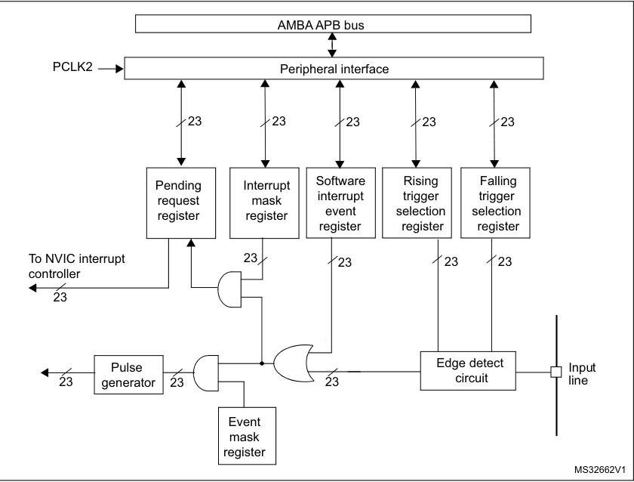

Slide 17
Clocks
Clocks act as the power and timing sources for the microcontroller
They determine when does an operation get executed, and at what speed does it execute.
Every action inside the MCU is synchronized to a clock signal
Clocks control the overall speed and behavior of the system.
Clock signals are typically generated using crystal oscillators
Crystals rely on piezoelectricity:
  Applied voltage causes mechanical vibration
  Vibration occurs at a precise resonant frequency
A feedback circuit sustains oscillation, producing a stable and accurate clock

Slide 18
Clock Sources
HSE –
  Generated using an external crystal/ceramic resonator or an external clock signal.
  Provides high accuracy for the main system clock
HSI –
  Generated using an internal 16 MHz RC oscillator
  Can be used directly as system clock or as PLL input
  Fast startup and no external components, but lower accuracy than HSE
LSE –
  Generated using a 32.768 kHz external crystal
  Highly accurate, low-power clock for RTC and calendar functions
LSI –
  Generated using an internal RC oscillator (~32.78 kHz)
  Used for independent watchdog (IWDG) and auto-wakeup

Slide 19
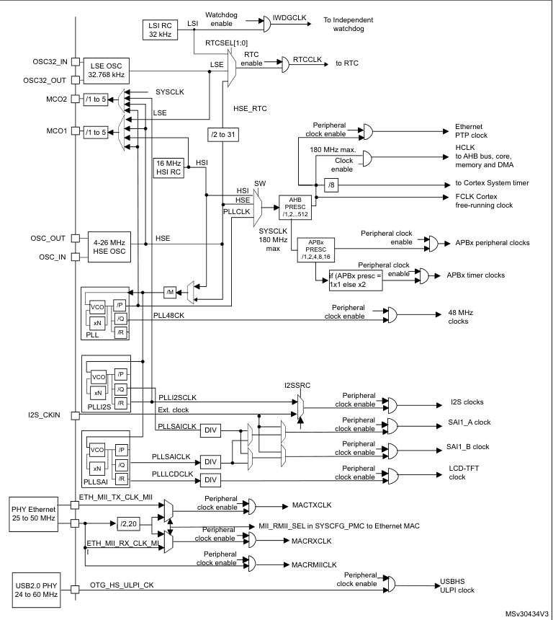

Slide 20
PLL
Acts as a frequency booster for the MCU clock (up to ~180 MHz).
Conceptually similar to a servo control loop.
Compares a reference clock with a VCO-generated clock.
A phase detector produces an error signal based on phase difference.
The error signal is filtered and used to tune the VCO frequency.
When “locked,” the VCO runs at the same frequency as the reference, with a steady control voltage.

Slide 21
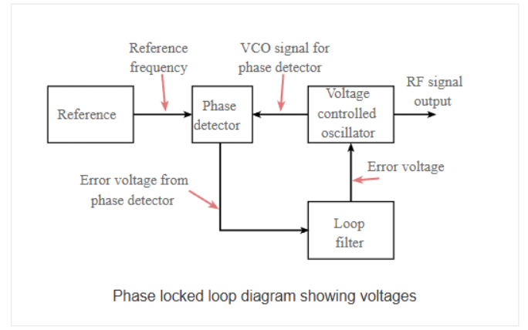

Slide 22
The END!

