Slide 1
GPIO Internals Overview
GPIO pins act as the interface between the processor core and the external world, allowing real world interaction.
  Every microcontroller exposes GPIO pins along the board edge, while internally they connect to transistor level circuitry.
  Without GPIO, the processor cannot receive input signals or control external hardware.
  GPIO pins have no predefined function and must be configured by software for specific behavior.
  Each pin can be programmed as input or output depending on system requirements.

Slide 2
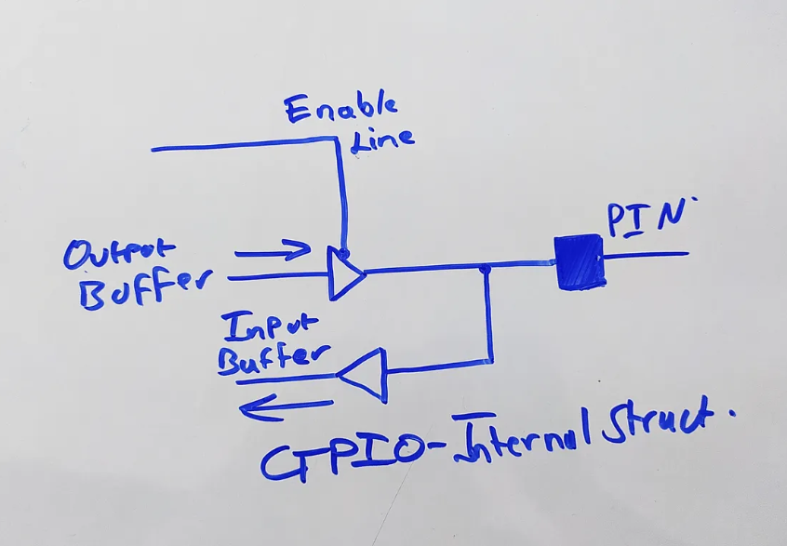

Slide 3
LET’s TALK MOS!
MOS technology is the backbone of MCUs: Modern microcontrollers are built using CMOS (NMOS + PMOS) transistors, which enables very low static power consumption, crucial for battery-powered and low-power embedded systems.
High integration density: MOS transistors scale extremely well, allowing CPU core, Flash, SRAM, GPIO, ADCs, timers, and peripherals to be integrated on a single silicon die.
Voltage-controlled operation: MOSFETs are voltage-driven devices with very high input impedance, which simplifies digital logic design and reduces loading on internal and external circuits.
Reliable switching for digital logic: CMOS logic provides strong logic-0 and logic-1 levels, good noise margins, and predictable timing—ideal for clocked digital circuits inside MCUs.

Slide 4
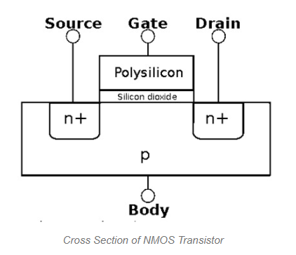

Slide 5
NMOS
NMOS is a type of MOSFET in which electrons are the majority carriers. It is fabricated using a p-type substrate with two heavily doped n+ regions forming the source and drain. The gate, insulated by a thin SiO₂ layer, controls electron flow between source and drain through an electric field.
With the body held at the lowest potential, the source–body and drain–body PN junctions remain reverse-biased. When a positive voltage is applied to the gate, an electric field attracts electrons to the Si–SiO₂ interface.
Once the gate voltage exceeds the threshold voltage, a thin n-type inversion layer (channel) forms, allowing current to flow between source and drain.
When the gate voltage is zero or below threshold, no channel exists and the transistor remains OFF.

Slide 6
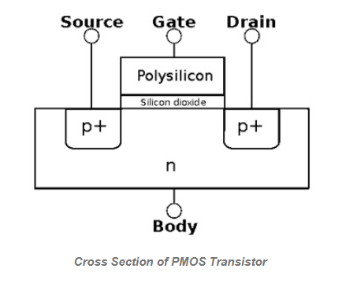

Slide 7
PMOS
PMOS, or P-type Metal Oxide Semiconductor, is a type of MOSFET in which holes are the majority carriers. The name comes from the use of p-type source and drain regions.
A PMOS transistor is fabricated using an n-type body (or n-well) with two heavily doped p+ regions adjacent to the gate, forming the source and drain.
The gate, insulated from the channel by a thin SiO₂ layer, controls hole conduction between the source and drain using an electric field. The body is typically tied to VDD (highest potential) so that the source–body and drain–body PN junctions remain reverse-biased.
When the gate voltage is equal to or higher than the source voltage, no inversion layer exists and the PMOS transistor remains OFF. When the gate voltage is pulled sufficiently lower than the source, holes are attracted to the Si–SiO₂ interface.
Once the gate-to-source voltage exceeds the threshold magnitude, a p-type inversion channel forms, allowing current to flow from source to drain and turning the transistor ON.

Slide 8
GPIO Input and Output Modes
In input mode, a GPIO pin samples external voltage levels and converts them into digital logic values.
  In output mode, the GPIO drives voltage onto the pin to control external circuits.
  Digital signals switch between defined voltage levels representing logic 0 and logic 1.
  Analog signals vary continuously and require ADC mapping when used with microcontrollers.
  Each GPIO pin has strict voltage limits such as 3.3V or 5V which must never be exceeded.

Slide 9
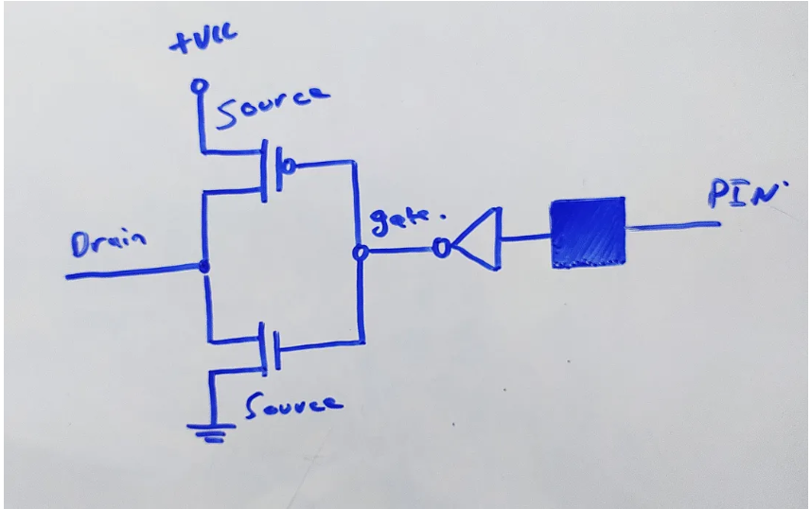
INPUT MODE

Slide 10
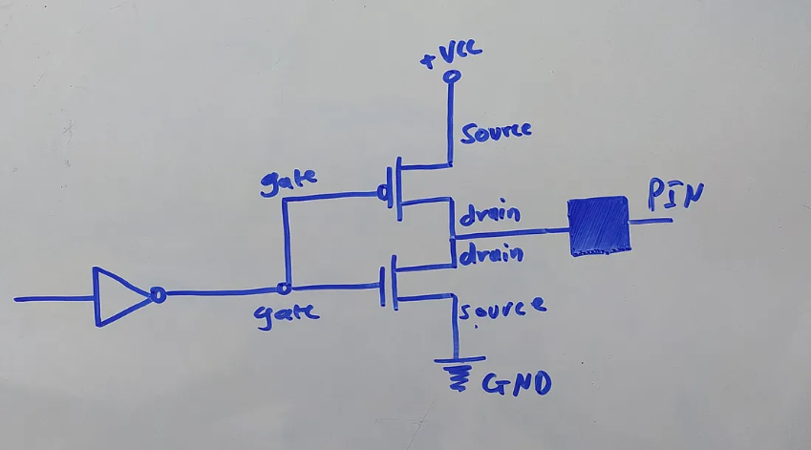
OUTPUT MODE

Slide 11
Internal Structure of a GPIO Pin
Internally, GPIO pins use input and output buffers typically implemented using flip flop-based storage elements.
  An enable control determines whether the pin operates in input or output direction.
  In input mode, voltage at the pin is sampled and stored inside the input buffer register.
  In output mode, data written to the output register drives the transistor pair connected to the pin.
  PMOS and NMOS transistors connect the pin either to VCC or ground based on the logic level.

Slide 12
IR Sensor with Basic GPIO
An IR module consists of an IR LED transmitter, photodiode receiver, and a comparator circuit.
  The IR LED emits infrared radiation which reflects from nearby objects and is detected by the receiver.
  The comparator converts the analog reflection signal into a clean digital HIGH or LOW output.
  The GPIO pin simply reads this digital signal without needing ADC or signal conditioning.
  From the MCU perspective, the sensor provides a direct logic level representing object detection.

Slide 13
7 Segment Display Fundamentals
A 7-segment display consists of seven individual LEDs arranged to form numeric digits.
  Each segment behaves like a diode and emits light when forward biased.
  Displays are available in common anode or common cathode configurations.
  In common anode, segments light up when the GPIO drives the segment line LOW.
  The microcontroller controls each segment by writing specific binary patterns to GPIO pins.

Slide 14
Driving a 7 Segment using GPIO
Each segment is connected to a dedicated GPIO pin, allowing direct digital control.
  Displaying a digit requires writing a predefined bit pattern corresponding to active segments.
  Lookup tables are commonly used to map numbers 0 to 9 to segment patterns.
  Current limiting resistors are mandatory to protect both LEDs and GPIO pins.
  Multiplexing allows multiple digits to share segment lines while enabling one digit at a time.

